Slide 1
Out-of-Band Pairing for Wireless Neural Implant
7/26/2024
Neuralink
US 2024/0232340 A1
Published 7/11/2024

Slide 2
Background
Brain-machine interfaces require fine-scale communication at the level of individual neurons - large #s across multiple brain areas
A large amount of information needed for processing & communication to outside world
Wireless solutions needed for more convenient communication & processing
Challenge of wireless solutions – data vulnerable to man-in-the-middle (MTTM) attacks
Need to securely transfer data to and from brain wirelessly

Slide 3
Outline
Goal: Describe a secure wireless pairing between neural implant & remote device that is via magnetic induction & neural signal analysis
Embodiments:
Perspective View of System with Implanted Device + External Device
Sectional Side View of Implanted Device
Normal Device Pairing
Attempt of Man-In-The-Middle Attack
Detection of Man-In-The-Middle Attack via Out-Of-Band Pairing Confirmation
Enabling & Aborting a Key Exchange via Out-Of-Band Pairing Code
Flowchart: Secure Pairing via Magnetic Induction
Flowchart: Secure Pairing via Neural Signal Analysis
Flowchart: Code Pairing Confirmation
Example Computer System

Slide 4
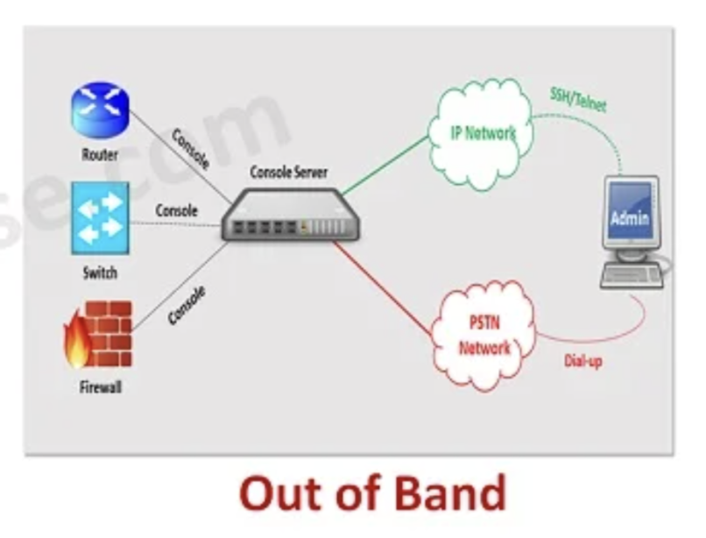
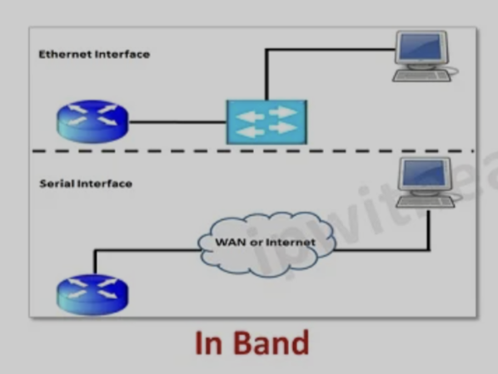
Out-Of-Band Authentication
Secondary verification through separate communication channel
Introduce additional layer of security via multiple, unrelated channels
Example: SMS one-time passwords, push notifications, biometric authentication (facial, voice, neural signals, etc.)

Slide 5
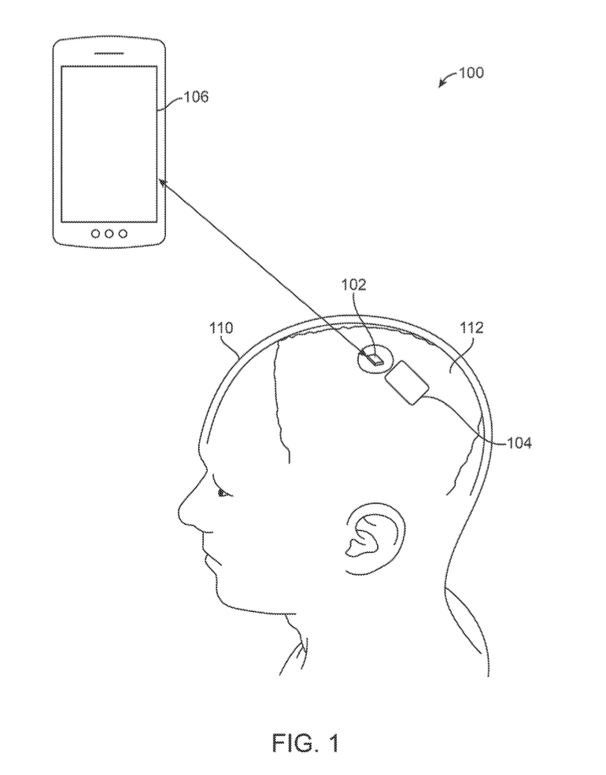

Perspective View of System with Implanted Device + External Device
External device (e.g., phone, laptop, etc.)
Note: Charging & External device can be same device
Implanted device
5-10mm
Brain
Subject
Charging device
Send/receive signals via magnetic induction optically, or by amplitude/frequency modulation
Relay device

Slide 6
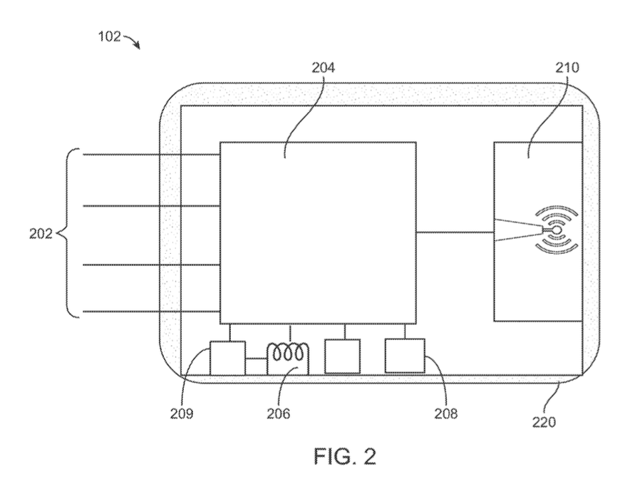
Sectional Side View of Implanted Device
Circuitry
IC chips for on-board amplification & digitization of data
Includes amplifiers, ADCs, and multiplexing electronics for digital packetization of brain signals
Can perform spike detection via thresholding or voltage vs time-analysis
Communications component
wireless transceiver
Initiates uplink communication via pairing techniques
Flexible electrodes
Small battery
Charging coil
(receive power from varying magnetic field via charging device)
Biocompatible case

Slide 7
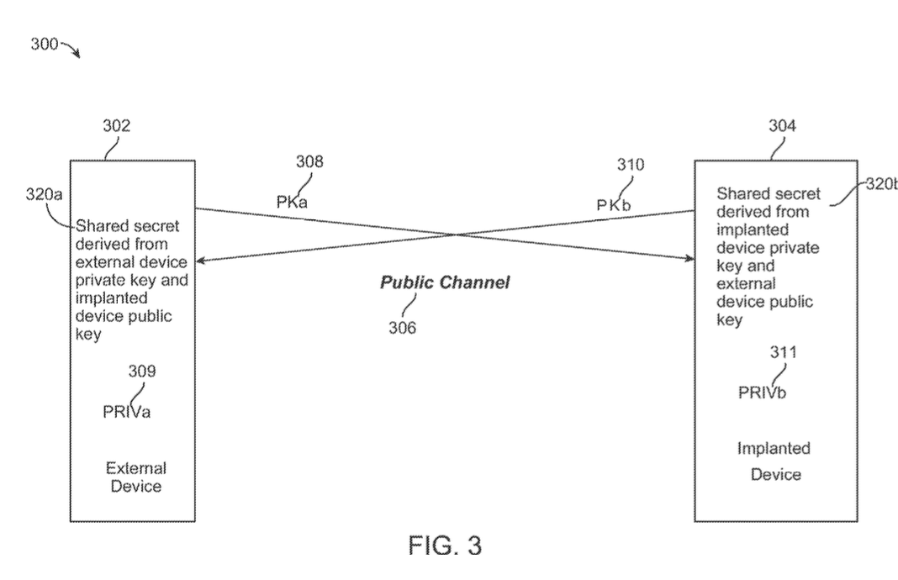
Key Exchange for Normal Device Pairing
Key exchange – devices communicate over public channel after secure pairing, involves constructing shared secret
Shared secret – used as encryption key on public channel after key exchange
External Device
Implanted Device
Public key (external)
Public key (implanted)

Slide 8

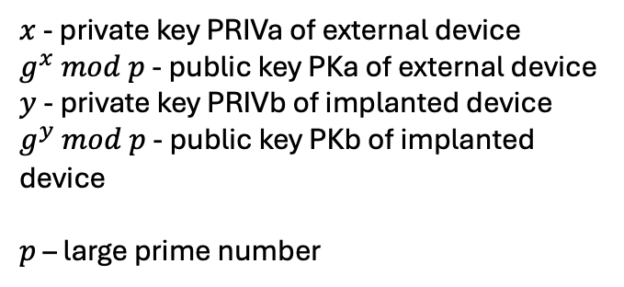
Diffie-Hellman Key Exchange (DHKE)
External device - generate external device public and private keys (PKa and PRIVa)
Implanted device - generate implanted device public and private keys (PKb and PRIVb)
External Device
Implanted Device
Public key (external)
Public key (implanted)
$x$ - private key PRIVa of external device
$g^{x} mod p$ - public key PKa of external device
$y$ - private key PRIVb of implanted device
$g^{y} mod p$ - public key PKb of implanted device
$p$ – large prime number

Slide 9
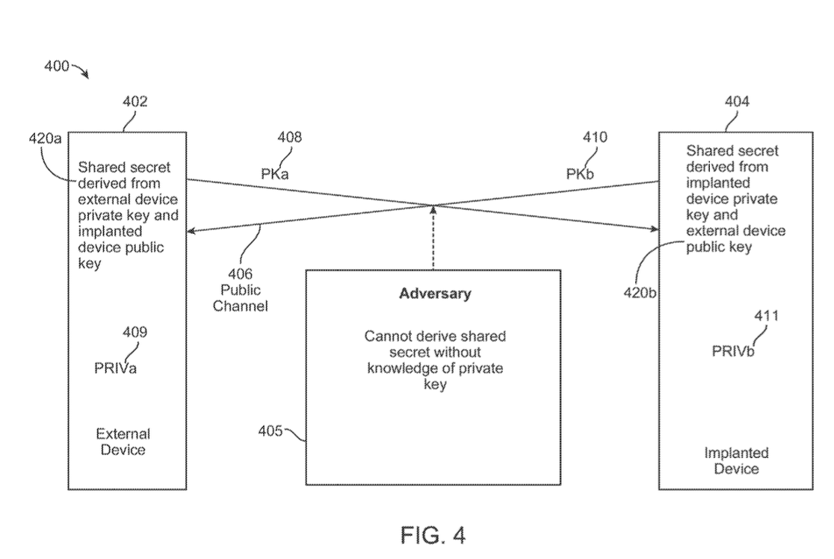

Attempt of Man-In-The-Middle Attack
Resistant to passive eavesdropping – computing public keys is infeasible without knowing private keys

Slide 10
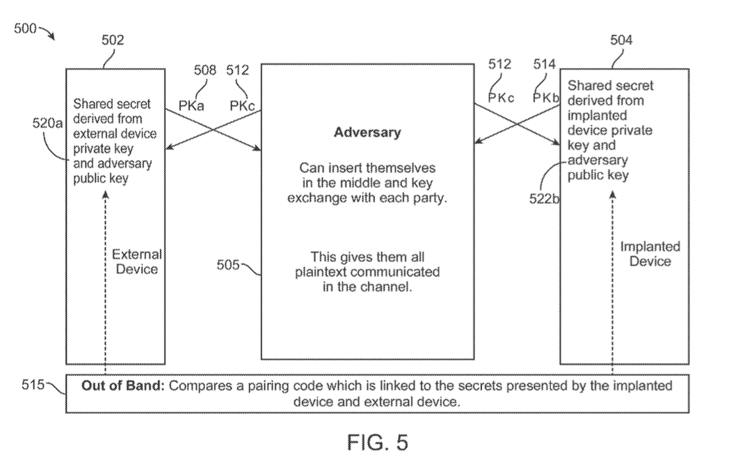






Detection of Man-In-The-Middle Attack via Out-Of-Band Pairing Confirmation
Out-of-band check:
Implanted & external devices generate random pairing codes derived from key exchange to third party via separate channel (see Bluetooth specs)
Compare both values (NOT match – MITM attack!)

Slide 11
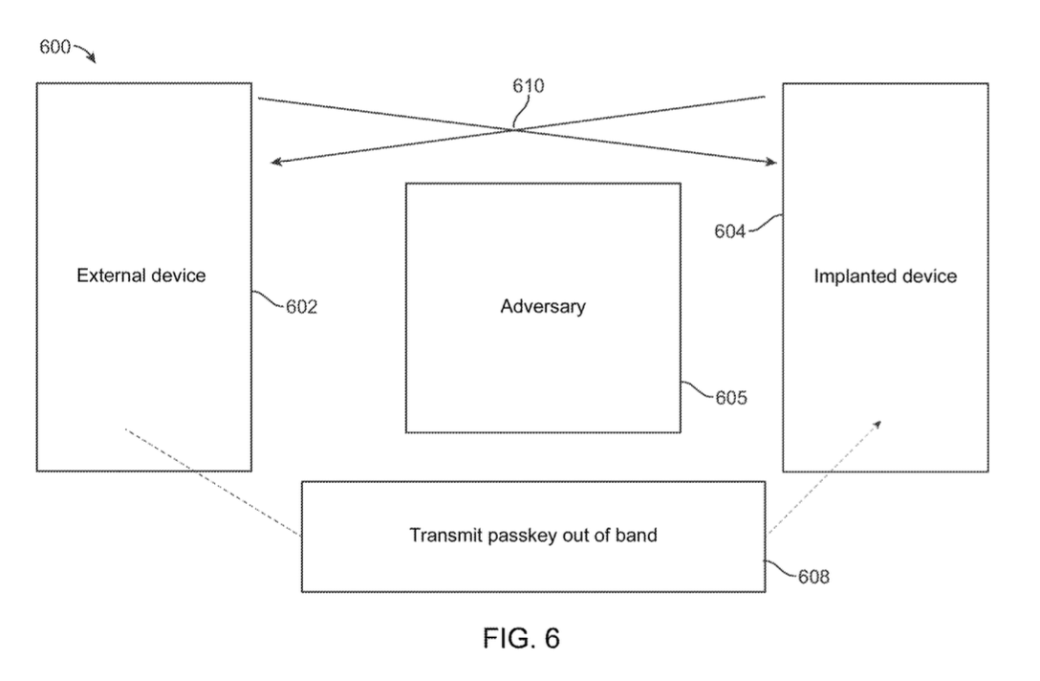

Out-Of-Band Data Transport: Enabling & Aborting a Key Exchange
Out-of-Band Data Transport – passkey/pairing code sent one-way from external device to implanted device (different from out-of-band check)
Use commit-reveal MITM protection (see Bluetooth specs)
Exchange hash outputs generated from candidate public keys, random nonce, and single bit of passkey at a time
If single output does not match output expected from any device → abort key exchange
Key exchange

Slide 12
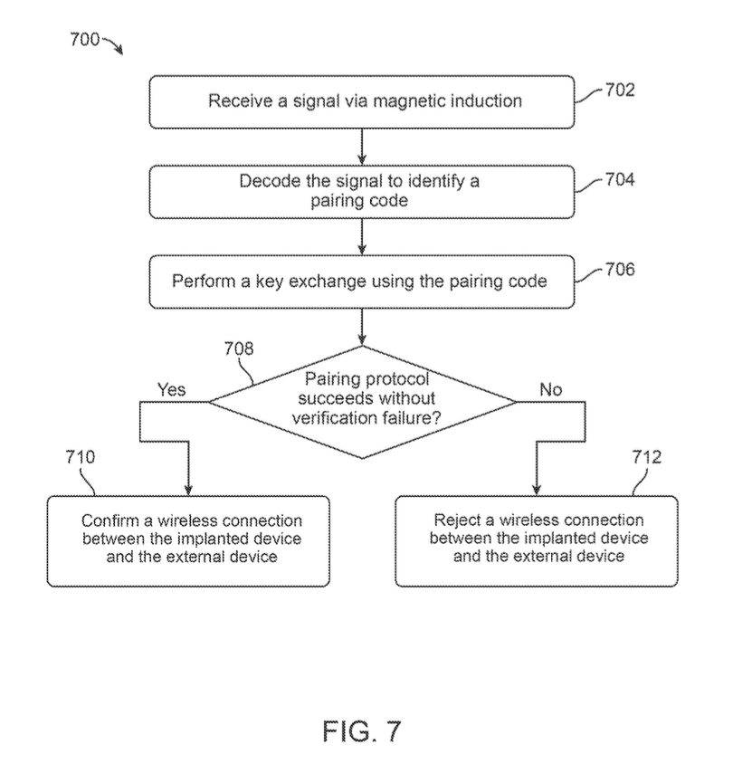






Secure Pairing via Magnetic Induction from Helper Device

Slide 13
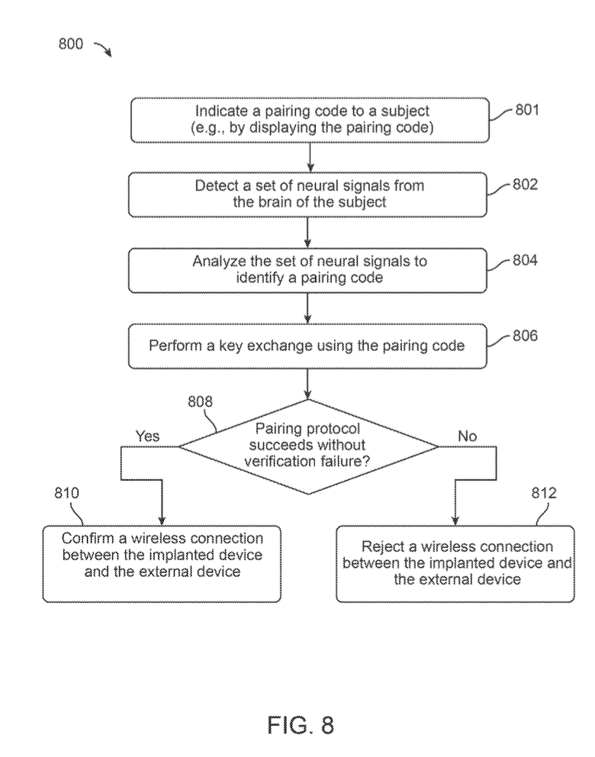





Secure Pairing via Neural Signal Analysis

Slide 14
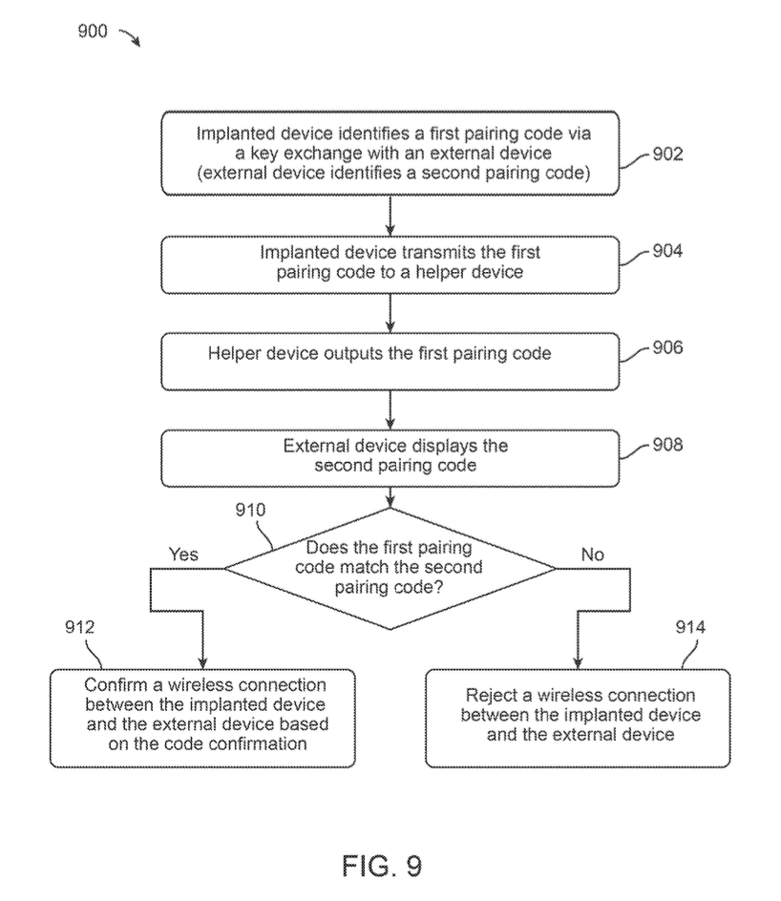



Secure Pairing via Pairing Code Transmission

Slide 15
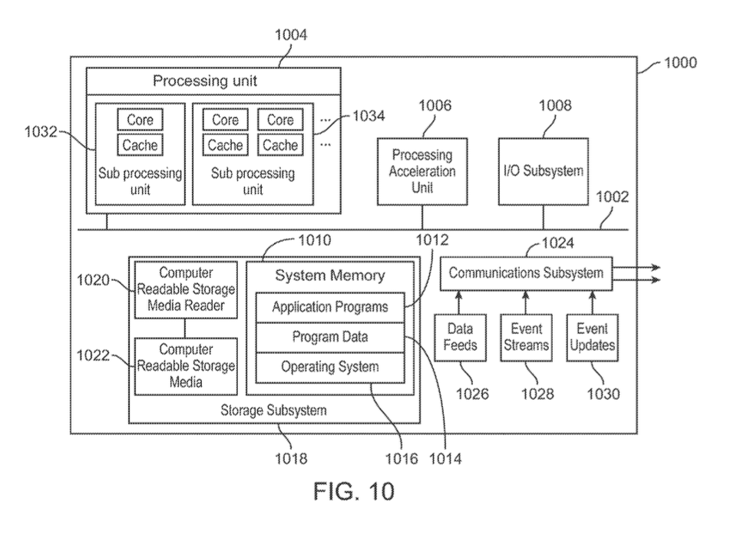
Example Computer System

